Slide 1
Development of bfsk modem for audio streaming application
Presented by
Joshua JJ Wonder (URK22EC1068)
Sujith S (URK22EC4025)

Slide 2

Outline
Introduction
Market Survey
Implementation Strategy
FlowChart
Results and Discussions
IQ Constellation
Conclusions
References
Acknowledgements

Slide 3

Introduction
Binary Frequency Shift Keying (BFSK) is a digital modulation technique that assigns distinct frequencies to binary data bits: one frequency for '0' and another for '1'.
Objective: To demonstrate BFSK modulation on an audio signal, simulate real-world noise, and reconstruct the original signal through BFSK demodulation.
Scope: This project modulates a 10 -second audio file, adds noise, demodulates the noisy signal, and reconstructs the audio signal for analysis.

Slide 4

Market Survey
Current Market Model
The current market for BFSK modulation techniques primarily targets digital communication systems where reliable data transmission is crucial, particularly in noisy environments.
Key Players: Prominent companies include Texas Instruments and Analog Devices, focusing on signal processing and modulation technologies.
Our Model
Our BFSK modulation and demodulation model processes audio signals to convert them into a binary stream, applies BFSK modulation, and reconstructs the original audio from the demodulated bits.
Potential Market Applications:
Audio Transmission Systems: Suitable for applications where audio clarity and data integrity are paramount, such as telecommunication and broadcasting.
IoT Communication: Can be applied in IoT devices requiring efficient data transmission in environments with varying noise levels.

Slide 5
Implementation Strategy
Audio Signal Processing:
Audio signal ("jackhammer.wav") is read and converted to a binary stream based on its amplitude, producing a digital format suitable for modulation.
BFSK Modulation:
Frequency f1 is used for binary '0', and frequency f2 for binary '1'.
Modulation is applied across the bit stream to generate a BFSK signal.
Adding Noise:
Gaussian noise is added to the BFSK signal, simulating real-world signal interference.
Demodulation:
The noisy signal is demodulated by analyzing the amplitude over each bit period, distinguishing between binary '0' and '1'.
Reconstruction:
Based on the demodulated binary stream, the original audio signal is reconstructed and saved as "reconstructed_audio.wav" for comparison.

Slide 6
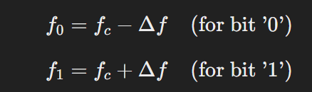

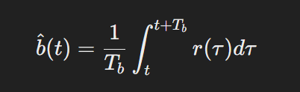
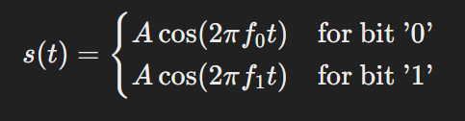
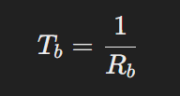
Mathematical Equation
Noisy BFSK signal
Bit Representation
Demodulated Signal
Modulated Signal
Bit Duration

Slide 7
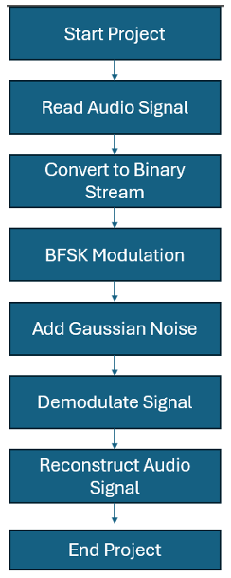
FLOW CHART

Slide 8
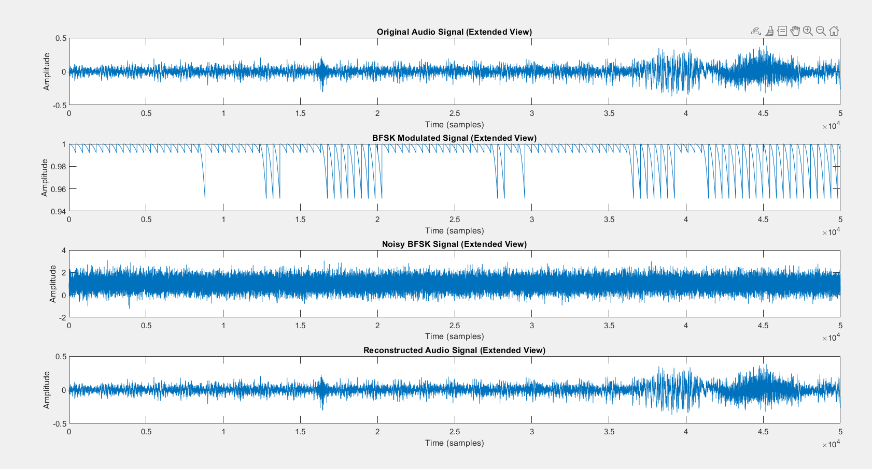
Results and Discussions
Original Audio Signal:
Plot Analysis: The original waveform displays the clean signal without modulation.
BFSK Modulated Signal:
Plot Analysis: Modulation results in frequency shifts that represent binary data.
Noisy BFSK Signal:
Plot Analysis: Added Gaussian noise demonstrates real-world interference, affecting signal clarity.
Reconstructed Audio Signal:
Plot Analysis: The reconstructed signal’s quality is affected by demodulation accuracy under noisy conditions.

Slide 9
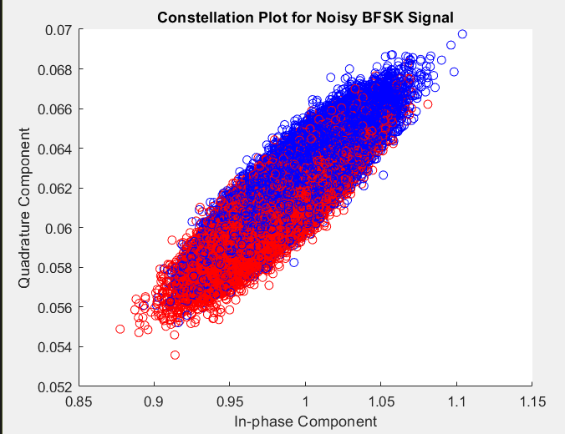
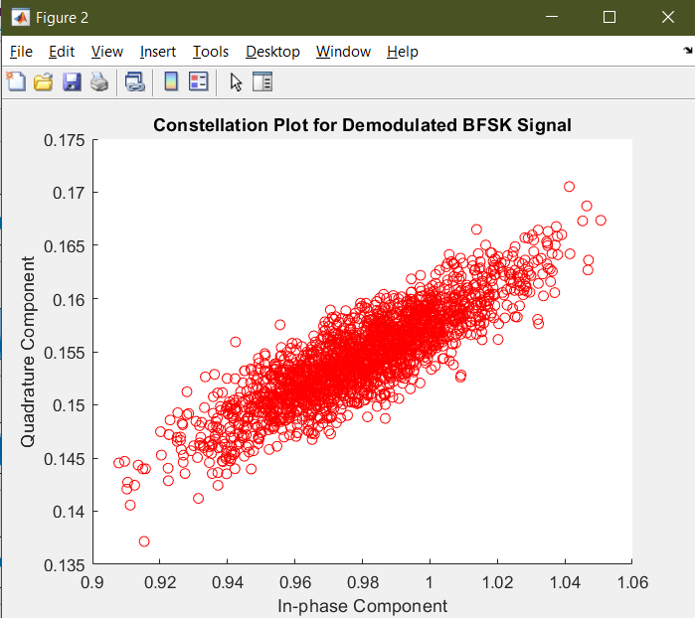
IQ Constellation Diagram

Slide 10

Conclusions
Achievements:
Successfully implemented BFSK modulation, simulated noise, and demonstrated demodulation and signal reconstruction.
Insights:
BFSK shows robustness against noise but still faces challenges in exact signal recovery under high interference.
The reconstructed audio retained some original qualities but showed degradation due to noise.
Future Work:
Implement adaptive filters to reduce noise impact.
Explore advanced modulation techniques for improved performance in noisy environments.

Slide 11
References
“Digital Communication Systems” by Simon Haykin.
MATLAB Documentation on audioread and audiowrite functions.
Academic articles on BFSK modulation and noise resilience.

Slide 12

Thank you

